Slide 1

Project Title
A Study of BHK Configurations in the Indian Real Estate Market
Presented by :
Nikhil Borade

Slide 2
About Me
Name – Nikhil Somnath Borade.
Education –Bachelor’s in Computer Science
GitHub – https://github.com/NiksNk555
LinkedIn – https://www.linkedin.com/in/nikhil-borade-307747314/

Slide 3
Buisness Problems :-
All property details are scattered, so buyers find it hard to compare.
Property websites don’t always give data in a way we can directly analyze.
People want to know clear insights like price trends, popular BHKs, and available amenities.
Having this information helps buyers, sellers, and investors make better decisions.
Objective of the Project :-
Collect property listings from the Nestoria website.
Study property trends like prices, sizes, cities, and amenities.
Show the insights with easy-to-understand graphs and charts.
Understand housing demand by BHK type and city.

Slide 4

Web Scraping :-
Web scraping is the process of extracting data from websites.
It is done using Python libraries like Requests, BeautifulSoup, and Regex.
The scraper sends a request to the website and receives HTML content in response.
Useful information is then parsed and extracted from the HTML code.
Finally, the data is cleaned and stored (CSV/Excel/Database) for analysis.
Notes:
“Web scraping is a technique used to automatically extract information from websites. In our project, we used Python libraries such as Requests, BeautifulSoup, and Regex to perform this process. The scraper first sends a request to the website and receives the HTML content as a response. From this HTML, we parse and extract the useful details like city, price, size, BHK, and amenities. Finally, the collected data is cleaned and stored in a structured format such as CSV, which makes it ready for analysis and visualization.”

Slide 5
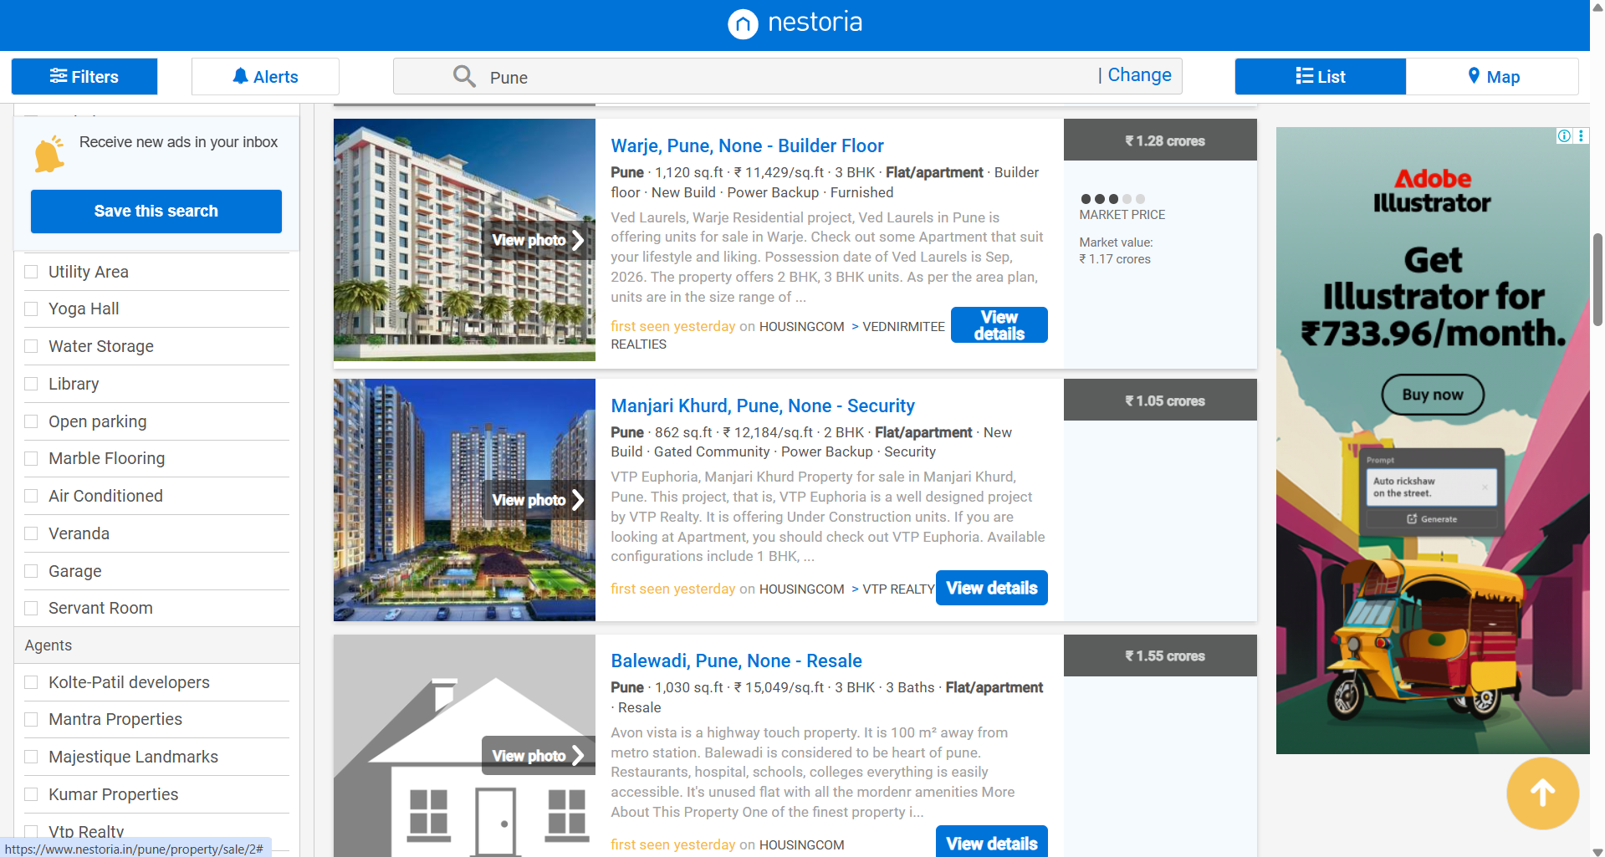
First look of site:-

Slide 6
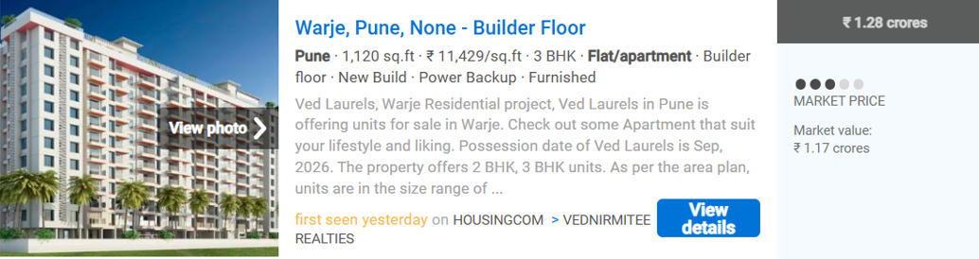
Extracting the content from the container :-

Slide 7
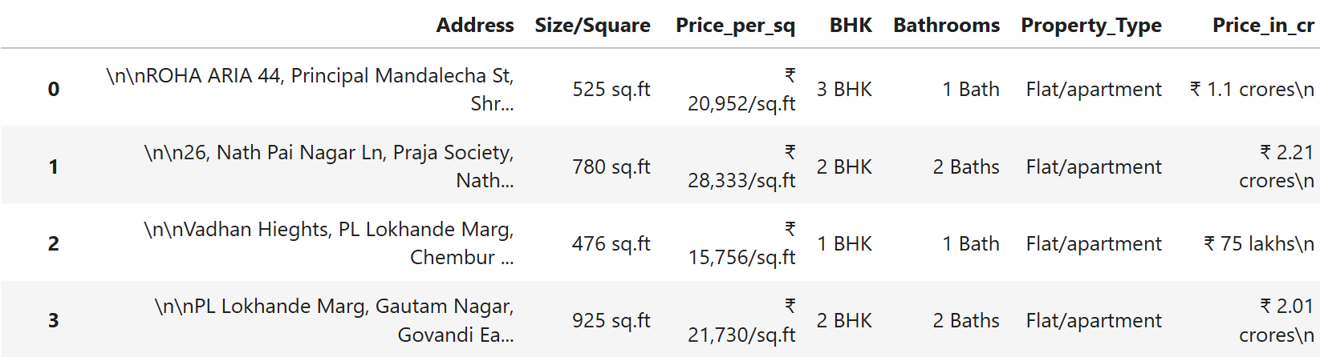
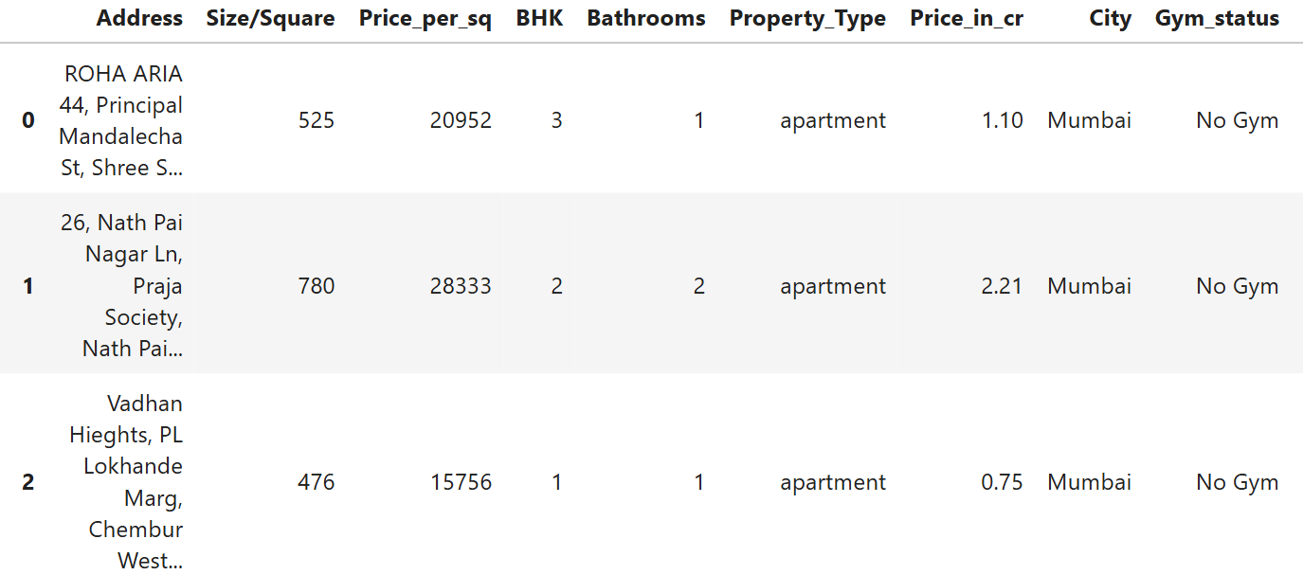
Old Data Frame :-
New DataFrame :-

Slide 8
Data visulatization
Importance of Data Visualization:-
Helps us understand data quickly through charts and graphs.
Makes it easier to spot patterns, trends, and outliers.
Converts complex numbers into simple visuals that anyone can understand.
Helps in better decision-making for buyers, sellers, and investors.
Allows us to compare cities, prices, BHKs, and amenities clearly.
Makes the project results more interactive and presentation-friendly.

Slide 9
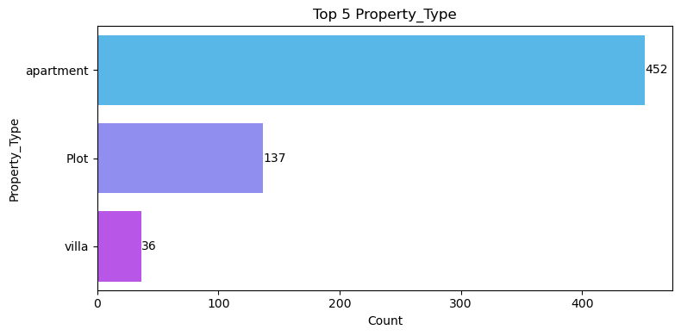
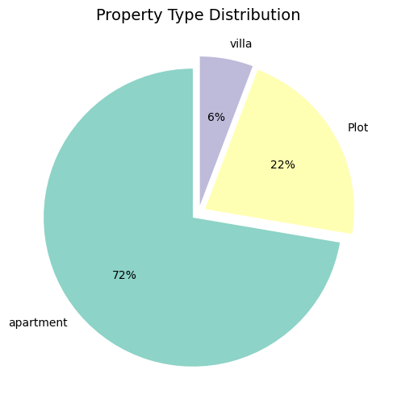
Univariate Analysis :-
Top 3 Property_Type
Apartments dominate the market with more than 70% of total properties.
Plots make up around 22% of the listings.
Villas are rare, with less than 6% share.
This shows that most buyers prefer apartments, while villas are a small luxury segment.

Slide 10
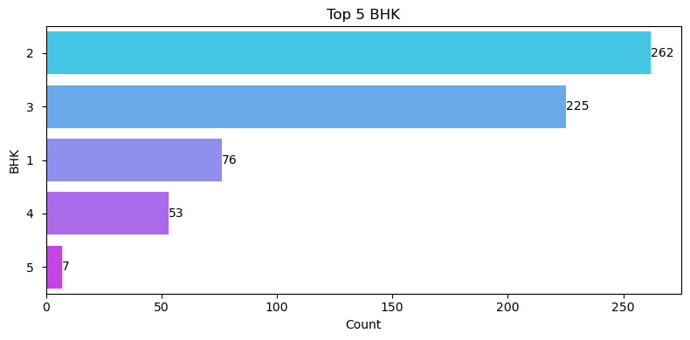
Top 5 BHK VS COUNT
2 BHK Leads the Market :- With 262 properties, 2 BHK units are the most common—indicating strong demand for mid-sized homes.
3 BHK Is a Close Second :- 225 properties show that 3 BHKs are nearly as popular, appealing to families needing extra space.
Luxury Segments Are Sparse :- 4 and 5 BHKs combined make up less than 15% of the total, suggesting limited supply demand for larger homes.

Slide 11
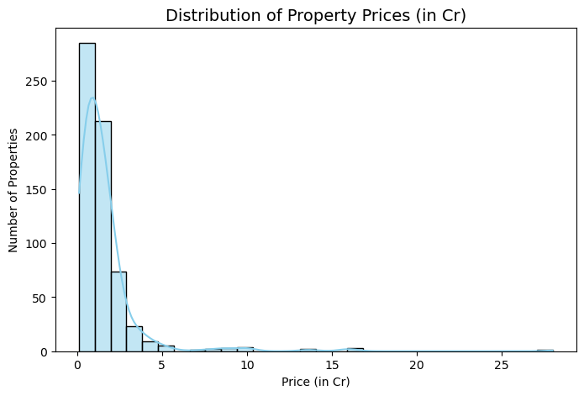
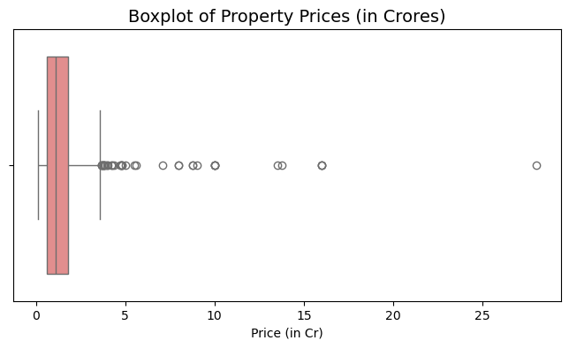
Distribution of Property Prices
Most properties are priced between 0.5 Cr and 3 Cr.
Very few properties go above 5 Cr, but they exist as outliers.
The market is skewed towards affordable and mid-range homes, with only a small luxury segment.

Slide 12
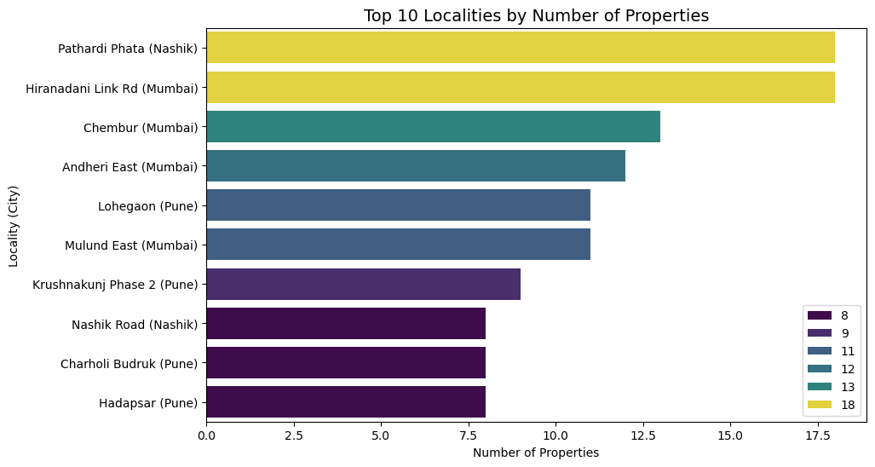
Top 10 Localities By Number of Properties
Pathardi Phata (Nashik) and Hiranandani Link Road (Mumbai) have the highest number of listings.
Popular Mumbai areas like Chembur, Andheri East, and Mulund East also appear in the top 10.
Pune localities like Lohegaon, Hadapsar, and Krushnakunj Phase 2 also have good representation

Slide 13
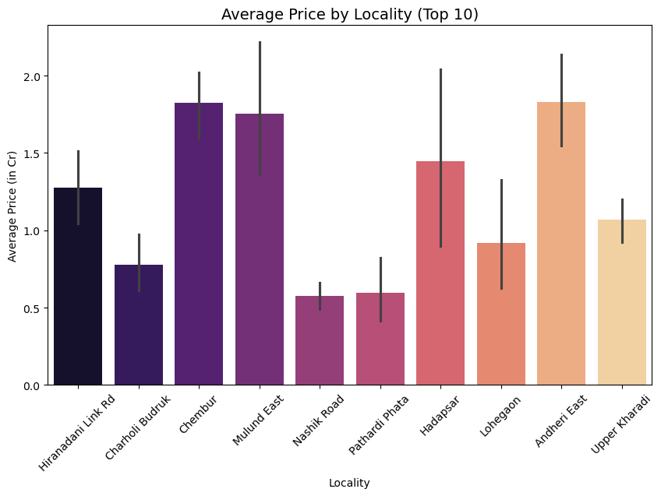
Bivariate :-
Chembur (Mumbai) and Andheri East (Mumbai) show the highest average prices.
Localities like Nashik Road and Pathardi Phata are among the most affordable.
Hadapsar (Pune) and Lohegaon (Pune) fall in the mid-range segment.

Slide 14
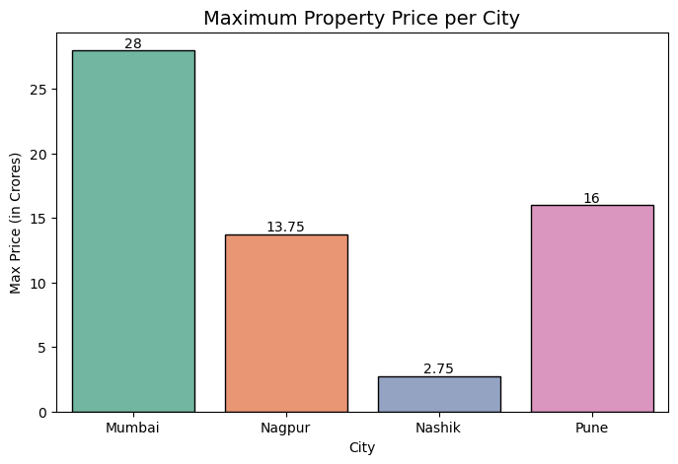
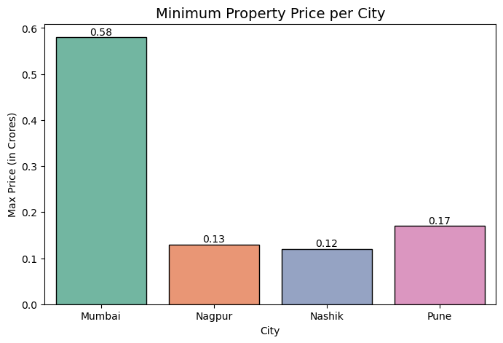
Maximum & Minimum Property Price Per City
Mumbai leads luxury: ₹28 Cr max price—highest among all cities.
Nagpur surprises: ₹13.75 Cr max hints at emerging premium zones.
Nashik is most affordable: ₹0.12 Cr minimum—ideal for budget buyers.
Pune offers range: ₹0.17 Cr to ₹16 Cr—diverse market for all segments.
Wide price gaps: Cities show strong internal segmentation in listings.

Slide 15
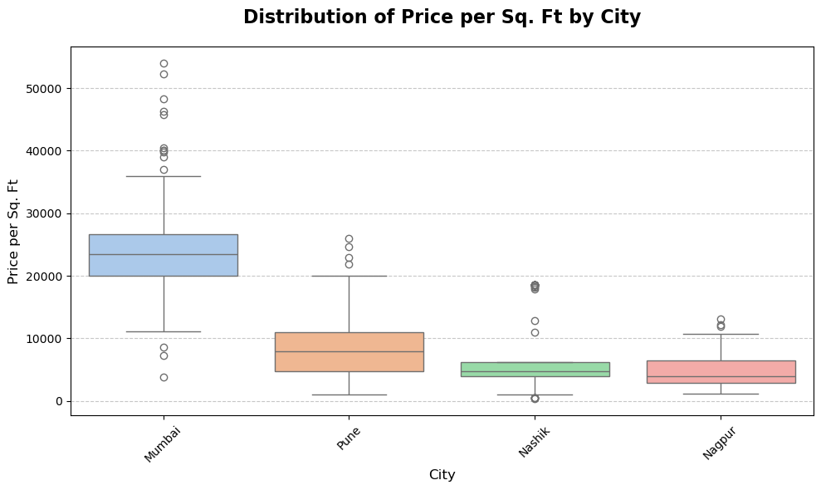
Distribution of Price Per Square Feet by City
Mumbai has the highest median price per sq. ft.
Mumbai shows the widest price variation and many outliers.
Pune offers balanced pricing with a moderate spread.
Nashik and Nagpur are more affordable and consistent.
Outliers suggest premium pockets in all cities.

Slide 16
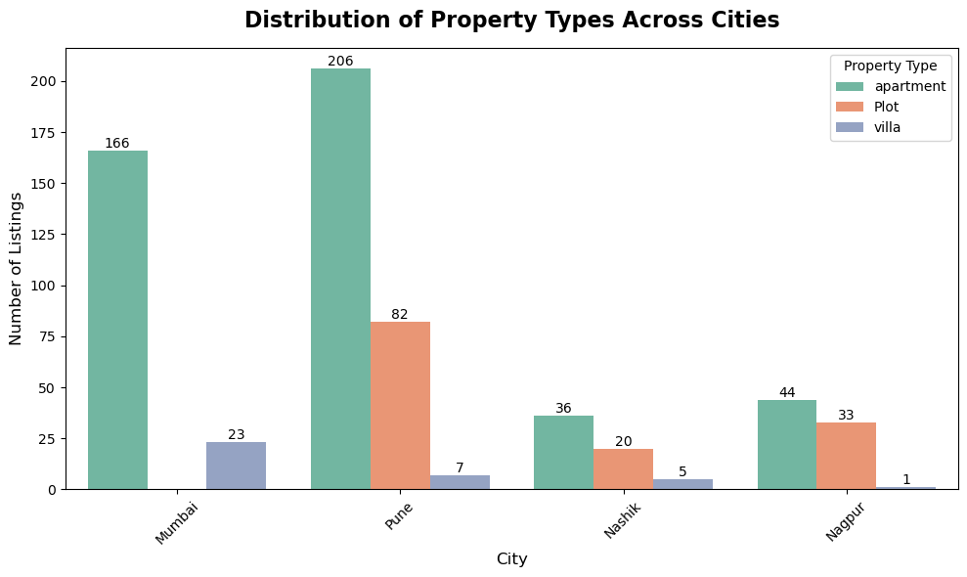
Distribution of Property Types Across Cities :-
Apartments dominate across all cities, especially in Pune (206) and Mumbai (166).
Plots are most common in Pune (82) and Nagpur (33), showing demand for land in these areas.
Villas are rare, with only a few listings in Pune, Nashik, and Nagpur—and none in Mumbai.
Mumbai’s market is highly apartment-centric, with almost no diversity in property type.
Pune offers the widest mix of property types, making it a more versatile market.

Slide 17
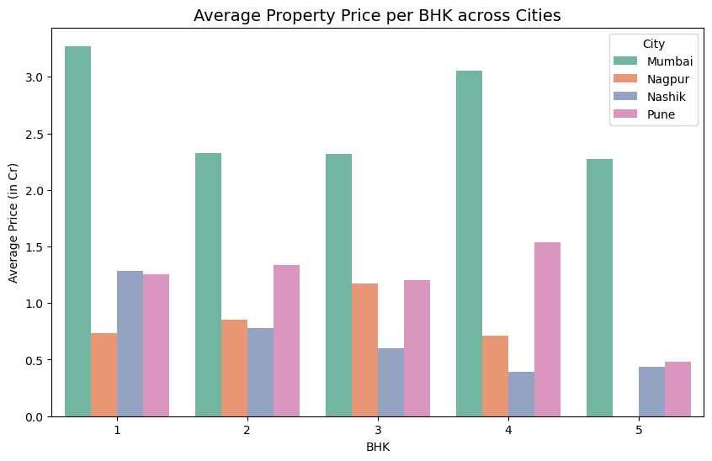
Average Property Price per BHK across Cities :-
Mumbai leads in pricing across all BHK categories.
Pune offers mid-range prices, consistently below Mumbai but above Nashik and Nagpur.
Nagpur and Nashik remain the most affordable, especially for higher BHKs.
Price increases with BHK count, but the jump is steepest in Mumbai.
Mumbai’s premium pricing reflects its high-end market positioning.

Slide 18
Conclusion :-
Mumbai consistently leads in pricing, both in median price per sq. ft. and across all BHK categories—reinforcing its premium market status.
Pune emerges as a balanced market, offering a wide mix of property types and moderate pricing, making it attractive for both investors and end-users.
Nagpur and Nashik remain the most affordable cities, with tighter price distributions and lower average prices, ideal for budget-conscious buyers.
2 BHK properties dominate in amenity availability, especially with features like gyms and lifts, indicating high demand and developer focus.
Apartments are the most listed property type, especially in Mumbai and Pune, while plots are more common in Nagpur and Nashik.
Villas are rare across all cities, with almost no presence in Mumbai, suggesting limited supply or niche demand.
Price per sq. ft. varies widely within cities, especially in Mumbai, hinting at a mix of luxury and budget segments coexisting.
Multivariate visualizations reveal layered insights, such as how property type, city, and BHK interact to shape pricing and amenity trends.
Data limitations from scraping were acknowledged, ensuring transparency and reinforcing the credibility of the analysis.

Slide 19

THANK YOU

